Slide 1


Slide 2
What is VCS? (Version Control System)
Version control is a system that records changes to a file or set of files over time so that you can recall specific versions later.
VCS allows you to revert files back to a previous state, revert the entire project back to a previous state, compare changes over time, see who last modified something that might be causing a problem, who introduced an issue and when, and more.

Slide 3
Types of VCS
Local VCS
Centralized VCS
Distributed VCS

Slide 4

Local VCS
Notes:
RCS (Revision Control System) is a popular local VCS tool used on Mac OS.

Slide 5
Local VCS
Programmers maintain versions of file on local machine.
Revision Control System (RCS) is a popular local version control system.
In single-user scenarios, such as server configuration files or automation scripts, RCS will be the preferred as it is simple & no central repository needs to be accessible for it to save revisions.

Slide 6
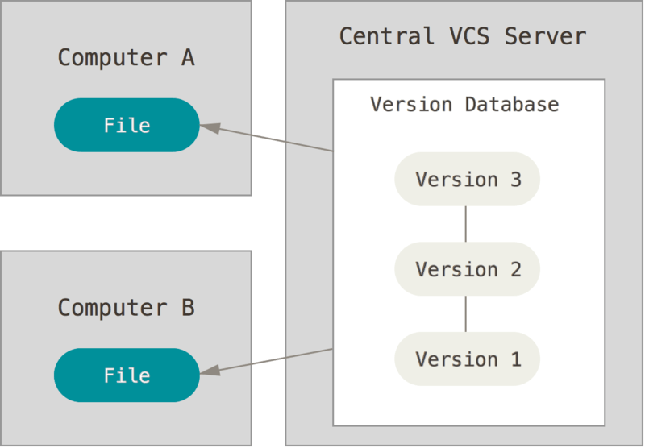
Centralized VCS
Notes:
The example of Centralized VCS is CVS, SVN, Perforce, ClearCase etc.
Disadvantages:

Slide 7
Centralized VCS
We may have several professionals working on one project. In such case, centralized VCS is used to maintain version control. Centralized VCS provide a single server machine where we maintain versions of our files.
The popular centralized VCS tools are CVS, Subversion, Perforce, ClearCase etc.
If central server goes down then developers cannot commit the code changes. Also, if central server hard disk becomes corrupt then we may loose entire data.

Slide 8
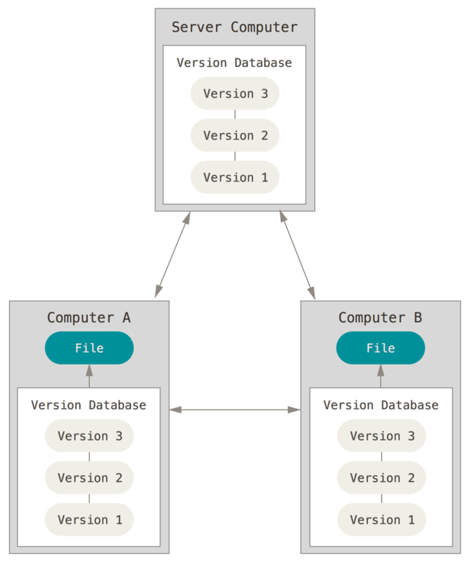
Distributed VCS
Notes:
The example of Distributed VCS is GIT, Mercurial, Bazaar or Darcs etc.

Slide 9
Distributed VCS
In distributed VCS, we maintain central repository as well as every developer maintains clone of central repository. The advantage here would be if central repository goes down or got corrupted, still local repository can restore your data.
Distributed VCS allows us to setup hierarchical repository model.
Example of distributed VCS is GIT, Mercurial, Bazaar or Darcs etc.

Slide 10

GIT History
Linux kernel was developed in 1991 & its code was committed in a proprietary DVCS called ‘BitKeeper’.
In 2005 since the relationship between Linux kernel & BitKeeper was broken down, Linus Torvalds developed GIT.
GIT is a free software & distributed under GPL.
Notes:
GIT means ‘Global Information Tracker’

Slide 11
Advantages of GIT
Most of operations are local. Hence you can work offline most of the times.
Faster in performing operations since most of operations happen on local repository.
Smaller repository space requirement. For example mozilla repository takes around 12 GB space in SVN where as in GIT it takes hardly 420 MB.
Moving files inside your repository is easier since GIT automatically tracks the moves. Whereas in other VCS you need to create a new file & then delete the old one.
Notes:
Taken from http://www.phpclasses.org/blog/post/309-The-Benefits-of-Using-Git-in-Your-Software-Projects-Part-1-Important-Advantages.html

Slide 12
GIT installation on windows
Visit https://git-scm.com/downloads
Download GIT latest version for windows OS.
Install the GIT executable file.
Make sure that git.exe file is added in the PATH. If not then please add it manually.
Open command prompt & run the command ‘git’. If it is working, it means GIT has been installed successfully.

Slide 13
Let us practice
Notes:
https://www.git-tower.com/learn/git/ebook/en/command-line/basics/basic-workflow

Slide 14
Initialize GIT repository
In your working directory, make an empty directory called ‘project_dir’.
>cd project_dir
>git init
>git status

Slide 15
Add a file into GIT repository
Make a file called hello.html using notepad++ and save it in the project_dir directory. Add this as the content of hello.html
<!DOCTYPE html><html><body>Hello World</body></html>
git status
git add hello.html
git commit –m “my first commit”
git status
git branch

Slide 16
GIT repository
GIT repository as a kind of database where you store all the versions and metadata of your project.
In GIT, the repository is just a simple hidden folder named ".git" in the root directory of your project. Knowing that this folder exists is more than enough. You don't have to and you should not touch anything inside this magical folder.
There are 2 types of repositories:
Local repository
Remote repository
Notes:
https://www.git-tower.com/learn/git/ebook/en/command-line/basics/basic-workflow

Slide 17
Local repository
A "local" repository resides on your local computer, as a ".git" folder inside your project's root folder.
You are the only person that can work with this repository, by committing changes to it.
Notes:
https://www.git-tower.com/learn/git/ebook/en/command-line/basics/basic-workflow

Slide 18
Remote repository
A "remote" repository is located on a remote server on the internet or in your local network.
No actual working files are associated with a remote repository.
It has no working directory but it exclusively consists of the ".git" repository folder.
Teams are using remote repositories to share & exchange data.
It serves as a common base where everybody can publish their own changes and receive changes from their teammates.
Notes:
https://www.git-tower.com/learn/git/ebook/en/command-line/basics/basic-workflow

Slide 19
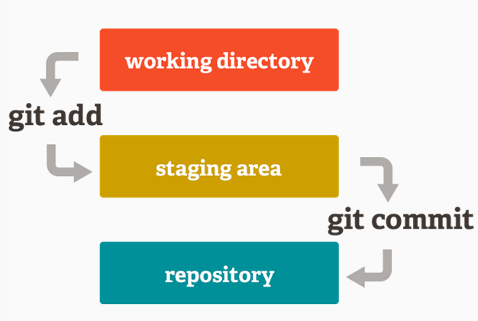
GIT workflow
Notes:
Refer https://www.git-tower.com/learn/git/ebook/en/command-line/basics/basic-workflow

Slide 20
Basic Git Workflow
You modify files in your working directory.
You stage the files, adding snapshots of them to your staging area.
You do a commit, which takes the files as they are in the staging area and stores that snapshot permanently to your Git directory.

Slide 21
Terminology
The .git Directory
This directory might be hidden. You will need to do ls –a to see it or in Windows Explorer you will need to turn on the option to see hidden files and folders.
The .git directory is where Git stores the metadata and object database for your project. This is the most important part of Git, and it is what is copied when you clone a repository from another computer.

Slide 22
Terminology
The Working Directory
The working directory is a single checkout of one version of the project. These files are pulled out of the compressed database in the Git directory and placed on disk for you to use or modify.
The Staging Area
The staging area is a file, generally contained in your Git directory, that stores information about what will go into your next commit. It’s sometimes referred to as the “index”, but it’s also common to refer to it as the staging area.

Slide 23
Making changes
Make changes in the hello.html file and save the changes.
>git status
Make a file called hello_again.html and save it.
>git status
>git add hello_again.html
>git commit –m “my second commit”
>git status
You will notice that the changes to hello.html are not committed because it wasn’t added to the staging area after changes.
>git log

Slide 24
Staging and Committing
Make a new file called hello3.html & run
>git add .
>git status
The . is a shortcut that says add all files in this directory and below. This particular command will add the unstaged hello.html (from earlier) as well as hello3.html to the staging area. Now make a change in the file hello3.html. Add a line and save it for example.
>git status
Notes:
Explanation

Slide 25
Staging and Committing continue…
Now there will be the same hello3.html file visible as staged as well as unstaged. If you commit, only the staged version will be committed.
>git add .
>git commit
Notes:
Explanation

Slide 26
Ignoring files (.gitignore)
The purpose of gitignore files is to ensure that certain files are not tracked. A .gitignore file has one pattern per line.
Patterns can have filepaths and wildcards. For example:
# Ignore configuration files that may contain sensitive information.
sites/*/settings*.php
# Ignore paths that contain user-generated content.
sites/*/files
sites/*/private
Notes:
Explanation

Slide 27
History
To see history, you can see use the following command
>git log
The command comes with many options:
>git log --pretty=oneline
>git log --pretty=oneline --max-count=2
>git log --pretty=oneline --since=“5 minutes ago”
>git log --pretty=oneline --until='5 minutes ago‘
>git log --pretty=oneline --author=<your name>
>git log --pretty=oneline --all
Notes:
Explanation

Slide 28
Aliases
Sometimes its useful to have shortcuts for frequently used commands or long command line options.
This is done by adding aliases to the .gitconfig file in your home directory. In Windows it is usually C:\users\username
Notes:
Explanation

Slide 29
Aliases continue…
Try adding the following in the .gitconfig file. Again this might be a hidden file. Find it and change this . The last line hist is useful. So add it exactly as given
[alias]
co = checkout
ci = commit
st = status
br = branch
hist = log --pretty=format:'%h %ad | %s%d [%an]' --graph --date=short
Notes:
Explanation

Slide 30
Changing a commit
Once you make a commit and you realize you left out something. You forgot something in the file or you realized that the commit message wasn’t correct. Git allows you to edit your previous commit – either change or add files that you left out and change the commit message also.
Notes:
Explanation

Slide 31
Steps for changing a commit
Change a file, stage it and commit it.
>git hist
Make another change and then
>git add hello.html
>git commit -–amend –m “oops forgot to add this line in the commit”
>git status
>git hist
Notes:
Explanation

Slide 32
Undoing changes
There are methods to undo your changes:
Before staging by using >git checkout hello.html
After staging by using
>git reset
After committing by using
>git revert
Notes:
Steps:
Create a new file hello.html
>git add hello.html
Make some change in the file.
>git checkout hello.html
Observe that previous version of hello.html is overwritten.
>git status
Observe that it is showing hello.html is green color.
>git reset
Observe that it is not showing hello.html.
>git revert HEAD
Revert last committed changes.

Slide 33
Branching
A branch represents an independent line of development.
Every branch has a brand new working directory, staging area and project history.
You can make changes, discard changes, make commits, record history, all without losing your original work.
A typical scenario is keeping your production code on master branch and each feature on a separate, new branch.

Slide 34
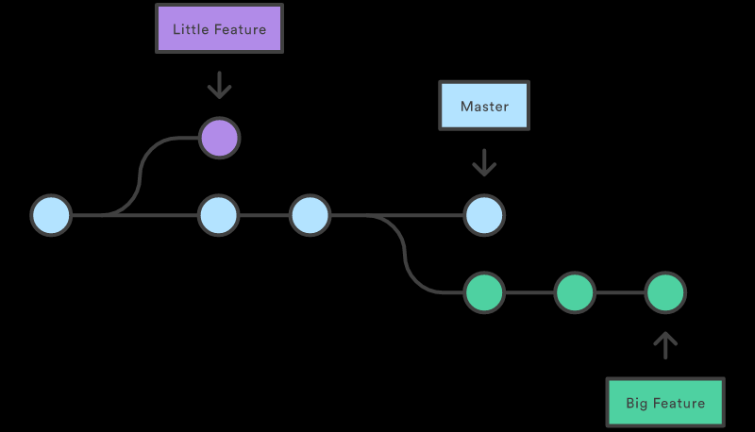
Branching Diagram
Notes:
Explanation

Slide 35
Branching commands
To create a new branch
git branch my-new-branch
To list all branches
git branch
To move to a branch
git checkout my-new-branch
To create a new branch and move to it (short-cut for the two steps above)
git checkout –b my-new-branch2

Slide 36
Branching Exercise
Create a new branch called dev-branch
git checkout –b dev_branch
git branch
Open the existing file hello3.html and make a change. Create a new file hello4.html. Add both to the staging area and commit both.
git status
git add .
git commit –m “checking how branches work”
Notes:
Explanation

Slide 37
Branching Exercise continue…
Now navigate back to the master branch. What happens to the file? Navigate back to the dev-branch. What happens now?
If you notice, the working tree changes to reflect the branch.
Notes:
Explanation

Slide 38
Merging
You have a development branch. This got tested and deployed to production. How do you now bring your master branch up to date?
This can be done with a merge or a rebase. We will discuss merging now and rebasing later.
Remember the steps for merging
Move to the main branch
Merge the side branch into the main branch.
After the side branch has been merged, you can delete it.
Notes:
Explanation

Slide 39
Merging (contd.)
git checkout master
git merge dev-branch
git branch –d dev-branch
If you try to delete an un-merged branch, Git won’t let you…unless you force it with a -D
Notes:
Explanation

Slide 40
Types of Merging
Fast forward merging
In fast forward merging, parent does not move ahead while branch merging.
True merging or 3-way merging
In true merging or 3-way merging, parent moves ahead while branch merging.
Notes:
Explanation

Slide 41
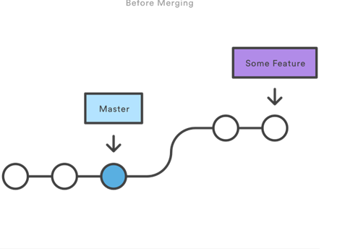
Fast Forward Merging
When the parent branch hasn’t moved ahead from when you branched off.
Notes:
Explanation

Slide 42
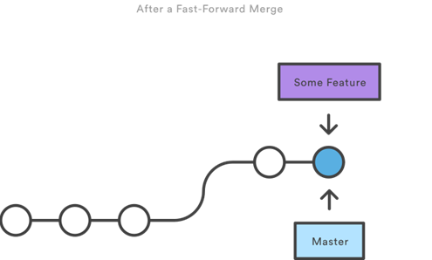
Fast Forward Merging
Notes:
Explanation

Slide 43
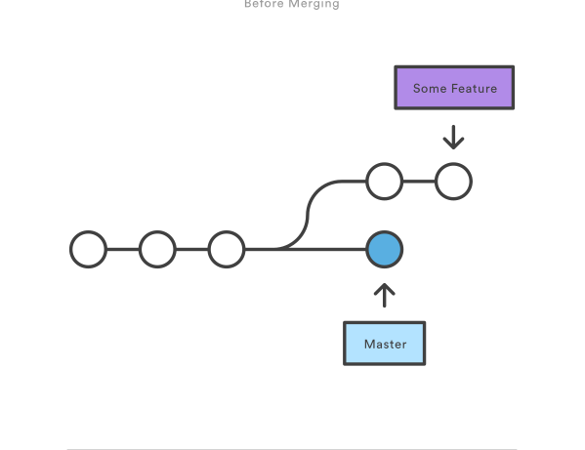
True Merging or 3-way margin
Original branching point
Tip of new branch3
Tip of master
Notes:
Explanation

Slide 44
True Merging or 3-way merging
True Merging – When the parent branch has moved ahead. We can divide true merging under 3 different cases:
Different files changed.
Same file has been changed but different line.
Same file is changed on same line.
Notes:
Explanation

Slide 45
Case 1: Different files changed
Make a new branch called new-branch3 and navigate to it.
Add a new file hello-newbranch.html in the new branch. Stage and commit it.
In the meanwhile there needs to be an urgent commit on the production branch. So go back to the master branch and make a new file called urgent_fix.html and add it to the staging and commit it.
Now navigate back to the new-branch3 make another change in hello-newbranch.html. Stage and commit.
Notes:
Steps:
git checkout –b new-branch3
git checkout master
git add urgent_fix.html
git commit –m “made an urgent fix”

Slide 46
Case 1: Different files changed
Now that you have completed development on your new feature on new-branch3, you want to merge it back to the master branch. How will you do this?
Move to the main branch (git checkout master)
Merge the side branch into the main branch. (git merge new-branch3)
After the side branch has been merged, you may delete it. (git branch –d new-branch3)
Notes:
Explanation

Slide 47
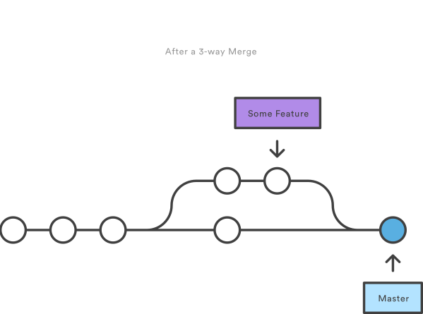
True Merging or 3-way merging
Notes:
Explanation

Slide 48
Case 2: Same File has changed but in different lines
Make a new branch called new-branch4 and navigate to it.
git checkout –b new-branch4
Change our original hello.html in the new branch in a part in the beginning of the file. Stage and commit it.
git add hello.html
git commit –m “added a new feature”
Now checkout to the master branch
git checkout master
Notes:
Explanation

Slide 49
Case 2: Same File has changed but in different lines
Change hello.html again but at the end of the file.
git add hello.html
git commit –m “made another urgent fix”.
Finally merge the new-branch4 into master.
Move to the main branch
Merge the side branch into the main branch.
git checkout master
git merge new-branch4 –m “merging both changes in the same file”
Confirm both branch changes are automatically merged.
Notes:
Explanation

Slide 50
Case 3. Same File has changed but in the same line
Make a new branch called new-branch5 and navigate to it.
git checkout –b new-branch5
Change our hello.html on the 10th line. Stage and commit it.
git add hello.html.
git commit –m “added a new feature on line 10”.
Now checkout to the master branch (git checkout master).
Change hello.html again but again on the 10th line.
git add hello.html.
git commit –m “refactored on line 10”.

Slide 51
Case 3. Same File has changed but in the same line
Now do a merge the same old way.
git checkout master
git merge new-branch5
Git doesn’t know which version to keep. So it will throw up a conflict like this.
Auto-merging hello.html
CONFLICT (content): Merge conflict in hello.html
Automatic merge failed; fix conflicts and then commit the result.
Notes:
Explanation

Slide 52
Case 3. Same File has changed but in the same line
Open the file in your editor. You will see conflict markers:
<<<<<<< HEAD
Lines added in master
=======
Lines added in branch
>>>>>>> new-branch5
One line marks what the line in the HEAD (or tip of the master is) and the other line shows you what is the version on the branch.
You edit the file manually. Keep the line that should be there. Remove the conflict markers from the file.
Notes:
Explanation

Slide 53
Case 3. Same File has changed but in the same line
To resolve the conflict:
Manually edit the file and keep the line that should be there. Remove the conflict markers
<<<<HEAD ====== >>>>new-branch5
Do this for every conflicting part marked by the conflict markers. Then stage & commit the file again.
git add hello.html
git commit –m “new feature successfully merged”
Notes:
Explanation

Slide 54
Case 3. Same File has changed but in the same line
Conflict resolution happens here
Notes:
Explanation

Slide 55
Rolling back a merge
Sometimes things can go wrong. You attempt a merge and Git throws up a conflict. You see that there is confusion as to what part of the file to keep and what to discard. Maybe you need to discuss this with the developer whose branch you are trying to merge. In such a scenario, you can abort the merge with the following command.
git merge --abort
This will roll back the attempted merge and you can retry after resolving whatever issue you had.
Notes:
Explanation

Slide 56
13. Rebasing
Rebasing is another way to combine your branch with the master branch.
Notes:
Explanation

Slide 57
Forked Commit History
Notes:
Explanation

Slide 58
Merging
Notes:
Explanation

Slide 59
Rebasing
Notes:
Explanation

Slide 60
What happens in a rebase?
Your current branch is rewound till the last branching point from the master and all your commits are stored in temp storage.
All the commits on master since you branched off are added in the right order.
All your old commits are added after this in the right order.
Notes:
Explanation

Slide 61
How to rebase?
This is how you rebase your feature branch onto the master branch. The order of this is important. You are rebasing YOUR branch onto the MASTER branch. This is done in the reverse way as merge.
Checkout your feature branch (git checkout feature)
Rebase your branch on master (git rebase master) At this point feature is like a branch from the latest commit on master. In this situation we can do a fast-forward merge.
Checkout master (git checkout master)
Do a merge which will be a fast forward merge. (git merge feature)
Notes:
Explanation

Slide 62
16. Conflicts during rebase
In case a conflict occurs at any step, you can
Abort the rebase git rebase --abort
Skip the commit (very rare and dangerous to use) git rebase --skip
Fix the conflict like you did during a merge conflict and then continue the rebase. git rebase --continue
Notes:
Explanation

Slide 63
17. Rebase Example
Make a tree like this.
Commit your master branch with commit messages M1, M2.
Then make a branch called my-branch. Make commits with messages B1, B2, B3. Checkout the master branch and make two more commits M3, M4.
Now checkout the new-branch and rebase your branch onto master.
git checkout my-branch
git rebase master
git hist
git checkout master
git merge my-branch
git hist
M1
M2
M3
M4
B1
B2
B3
Notes:
Explanation

Slide 64
Difference Between merge and rebase
Merging introduces a commit every time there is a merge while rebase doesn’t.
Rebasing allows you to have a perfectly linear history.
Rebasing allows you to rewrite the history.
With rebasing you can lose history while merge is safe.
Rebasing should NEVER be done on a public branch.
Notes:
Explanation

Slide 65
When do you use a rebase usually?
To avoid many merge commits. If the master branch is very active, and you have to keep merging, you will get a new commit for every merge. In such a case rebase would make sense.
Rebase is also used to do a rewrite of history. If you had a lot of frequent and small commits on your branch and you want to combine them together before merging with master then rebase allows you to do that.
Notes:
Explanation

Slide 66
Other useful git commands to know
git rebase –i master
Interactive Rebase . Allows you to interactively change commit messages and squash commits together
git reflog
Allows you to look at how the HEAD has changed over time and various commits.
git stash
Allows you to temporarily store unstaged files before doing a checkout.
Notes:
To revert stash, use >git stash list & >git stash apply stash@{0}

Slide 67
Other useful git commands to know
git stash list
Lists down all stash you have made so far with stash id.
git stash apply stash@{0}
Applies the stash with specific stash id. This step will get your local changes back.
Notes:
Explanation

Slide 68
Remotes
A remote git server is useful for collaborating between multiple developers or even syncing your own work between machines.
Github and Bitbucket are two popular Git server providers.
WARNING :- The code you share on a Server may be public. Please be very mindful of this when using github or bitbucket.
You can create private repositories but these are usually paid accounts.
Notes:
Explanation

Slide 69
Remote (Exercise)
Make a directory called work2 (cd work2)
git clone https://github.com/mockingbirdz/gitcourse
cd gitcourse
git branch
The remote branches show as remotes/origin/<branch-name>. ‘origin’ is the remote alias set for the repository that you have cloned from. You can also add remotes with other aliases e.g. prod, staging, uat, test.
git remote add prod https://github.com/mockingbirdz/prod
Notes:
Explanation

Slide 70
Remote (Pushing Changes)
Make changes in your working directory, stage and commit.
git add .
git commit –m “my commit”
One person push their changes.
git push (Please note that you need valid credentials to push)
This will push the current branch to origin.
To push a specific branch to a specific remote
git push <remote-name> <branch-name>
Notes:
Explanation

Slide 71
Remote (Pushing Changes after the remote has moved ahead)
Everyone else try pushing their changes. You will get an error
! [rejected] master -> master (fetch first)
error: failed to push some refs to 'https://github.com/mockingbirdz/gitcourse.t'
hint: Updates were rejected because the remote contains work that you do
hint: not have locally. This is usually caused by another repository pushing
hint: to the same ref. You may want to first integrate the remote changes
Notes:
Explanation

Slide 72
Syncing with the remote (rebasing)
To get what changes have happened since your last commit
git fetch (It fetches remote data)
git branch –-all (Shows all the branches including the remote branches)
git diff origin/master (Will tell you the difference between current and remote master)
Now how do we sync it to our master? The preferred way is to rebase.
git rebase origin/master
Notes:
Explanation

Slide 73
Syncing with the remote(merging)
You can also merge after fetching. That will cause an additional merge commit.
git merge origin/master
A pull is a combination of a fetch and a merge.
git pull
To pull a specific branch
git pull <remote-name> <branch-name>
Notes:
Explanation

Slide 74
Workflows
Git allows developer teams to collaborate with each other using remote servers.
Git also provides the flexibility to set certain workflows for collaboration.
This next section will explore the various possible workflows.
Notes:
Explanation

Slide 75
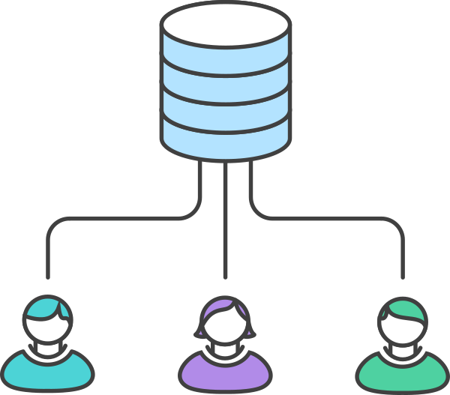
Centralized Workflow (diagram)
Notes:
Explanation

Slide 76
Centralized Workflow
Each developer clones from the central repository.
Each developer develops and commits locally.
Each developer pushes to server.
In case the central repository has moved ahead, the developer will pull or rebase and then push.
Similar to SVN.
Everyone has equal rights on the master repository.
Notes:
Explanation

Slide 77
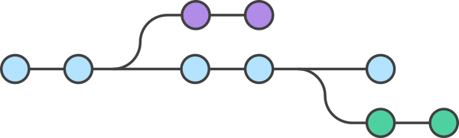
Feature Branch Workflow
feature-1
master
feature-2
Notes:
Explanation

Slide 78
Feature Branch Workflow
The master branch is the official branch
Every feature is developed on its own separate branch
Once a branch development is complete and the code is stable, it becomes merged into master
Merging is usually done with a pull request.
Try out a pull request.
Make a branch in your code. Make changes, stage and commit on the branch and push the branch.
Then make a pull request on Github.
Notes:
Explanation

Slide 79
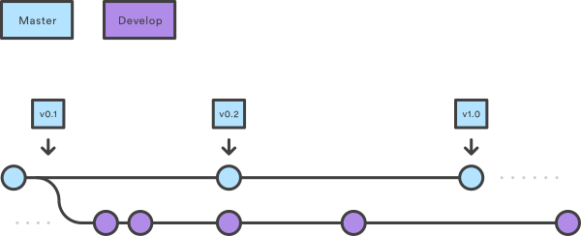
Gitflow Workflow
The prod branch is the master. Development happens on a release branch.
Notes:
Explanation

Slide 80
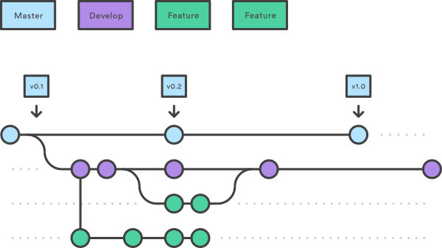
Gitflow Workflow
All features are developed by branching off the feature branch and merging back once development is complete.
Notes:
Explanation

Slide 81
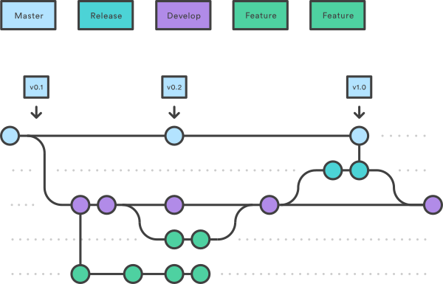
Gitflow Workflow
Once the development for the release is complete (either development is complete or date is reached), then release branch is merged back into master.
For the next release, a new branch is again created from master.
Notes:
Explanation

Slide 82
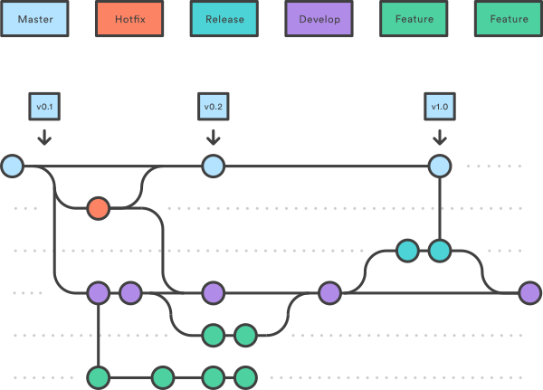
Gitflow Workflow
Any hotfixes (urgent patches) are developed by branching off master and then merging back. These are also merged into the release branch.
Notes:
Explanation

Slide 83
35. Useful Resources
Pro-Git Book
https://git-scm.com/book/en/v2
Atlassian’s Git tutorial
https://www.atlassian.com/git/tutorials/
Github’s Interactive Tutorial
https://try.github.io/
A guide for the perplexed
http://think-like-a-git.net/
Git Immersion
http://gitimmersion.com/
Git from the bottom up (a look at exactly how Git works)
http://ftp.newartisans.com/pub/git.from.bottom.up.pdf
Linus Torvald’s TechTalk at Google on Git (purely for entertainment)
https://www.youtube.com/watch?v=4XpnKHJAok8
Notes:
Explanation

Slide 84
Thank You For Participating
CONTACT
PHONE:
+91 9930 777 883
LinkedIn
https://tinyurl.com/onkarProfile
EMAIL:
onkar.java@gmail.com

